Slide 1
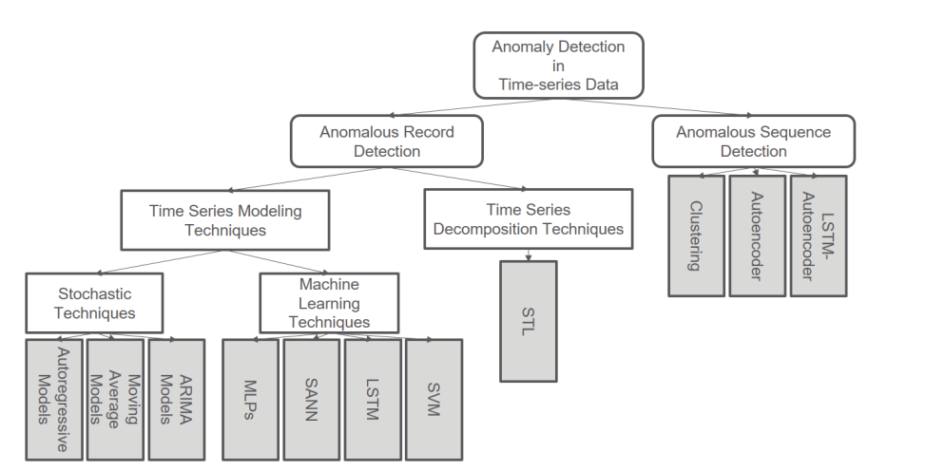
Time – Series Outlier Detection
Read, Parse and understand data
Run mutation scripts on data
Extraction of TS features using py2R and R with oddstream
Implement Decomposition technique for anomalous record detection
STL [refs 78,79,80]
Apply implemented decomposition techniques for outlier record detection on mutated data.
Implement Stochastic TS Modelling techniques
AR [ref 68]
MA [ref 67, other internet refs]
ARIMA [same source as 68]
Apply implemented modelling techniques for outlier record detection on mutated data.
Implement ML techniques for TS modelling
SVM[ref 67 + more]
Notes:
1

Slide 2
Data Preprocessing
One approach is to decompose the time series into pattern and features.
Therefore some kind of window size needs to be set.
However, since time series are often incorporated with seasonality, we used the partial auto correlation [9] to automatically determine a window size. We chose a value for the window size which was slightly higher than the highest correlated value at least 11 points away.
Ref: Anomaly Detection in Univariate Time Series: An Empirical Comparison of Machine Learning Algorithms Sina Daubener1 , Sebastian Schmitt2 , Hao Wang3, Peter Krause1 , and Thomas Back3 https://www.honda-ri.de/pubs/pdf/4015.pdf

Slide 3
Data Preprocessing [2]
Next to data operations like scaling, detrending, log-transformation and normalization [2,5,29] we conducted another experiment where we computed the first order differences of the time series and used these as inputs. However, this did not improve the F1 scores so no pre-processing was applied for our final results in Chapter 4.
To analyze the sensitivity of the approach based on w, we tested the window sizes w ∈ {5, 10, 15, 20} and found that the results are insensitive to a choice from those four values. However, to provide a consistent learning window, we use w = 10 in the following.
Ref: Anomaly Detection in Univariate Time Series: An Empirical Comparison of Machine Learning Algorithms Sina Daubener1 , Sebastian Schmitt2 , Hao Wang3, Peter Krause1 , and Thomas Back3 https://www.honda-ri.de/pubs/pdf/4015.pdf

Slide 4
Pre-processing Time Series
Self Lag Differencing — It can be taken as the difference between the present series and a lagged version of the series. The shift can be of the order 1,2,3,4, etc. For items where we don’t have any lagged version item, take them as NULL.
Log Self Differencing — It can be taken as the difference between present series and a lagged version of the series. But you can just apply log transformation over the actual series.
And the best method to follow up is using:
from statsmodels.tsa.seasonal import seasonal_decompose
Use seasonal_decompose and it will give you three components-Trend, Seasonality and Residuals. Take these residuals and it will be our stationary time series for forecasting.
Ref: https://medium.com/data-science-in-your-pocket/preprocessing-for-time-series-forecasting-3a331dbfb9c2

Slide 5
NA Values
Lagged values in MA are NAN -> Dropped them
AR model – model trained with lag = 30 ~ =
AR predictions – tutorial followed from 1 – len(df) - 1 ~ few nan values -> replaced with 0 to be able to calculate MSE.
Differencing with time series with t-1 lag would make it lose that one value.

Slide 6
Performance Measures
1. True positives (TP): The number of anomalies correctly detected as such.
2. False positives (FP): The number of data points labeled by the underlying algorithm as anomalies even though they are normal instances.
3. False negatives (FN): The number of anomalies that are not detected.
4. Precision: The ratio of correctly labeled anomalies over all anomalies which are detected, i.e.: precision = TP /TP + FP .
5. Recall: The ratio of all correctly labeled anomalies over all actual anomalies, i.e.: recall = TP/ TP + FN .
6. F1 score: The harmonic mean between precision and recall, i.e. F1 = 2 · precision·recall /precision+recall . This is the most reliable score since maximizing precision and recall are often conflicting goals.

Slide 7
Anomalous Record Detection Approaches
STL Decomposition
AR
MA
ARIMA and SARIMA
SVM
SANN
MLPs
LSTM

Slide 8
STL Decomposition
STL Decomposition on Yahoo S5 Dataset
Manual Threshold setting
2 Std Deviations threshold
IQR
MAD

Slide 9
STL Decomposition
Use the Additive Decomposition of the Time Series
Focus on Residuals
Set Manual threshold
If residual value > threshold, then outlier.

Slide 10
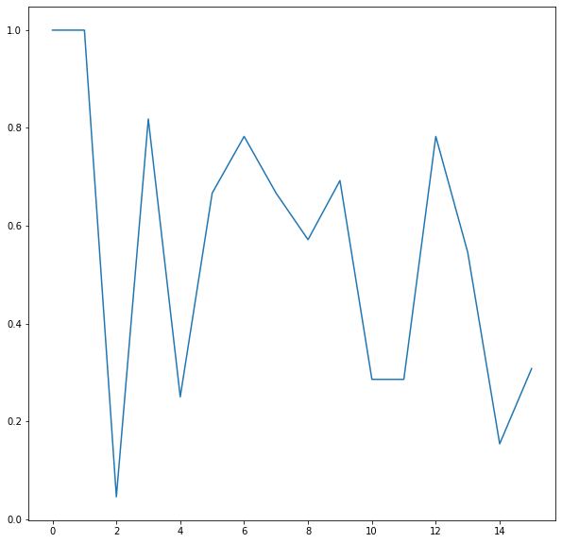
STL 15 Runs – F1 Score – Raw Data
Average F1 = 0.553396558151993

Slide 11
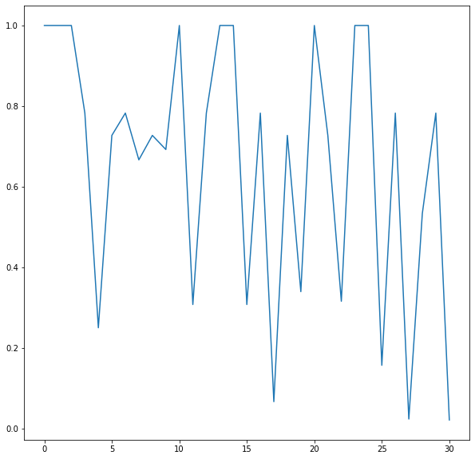
STL 30 Runs - F1 Score – Raw Data
Avg F1 - 0.36248695501582145

Slide 12
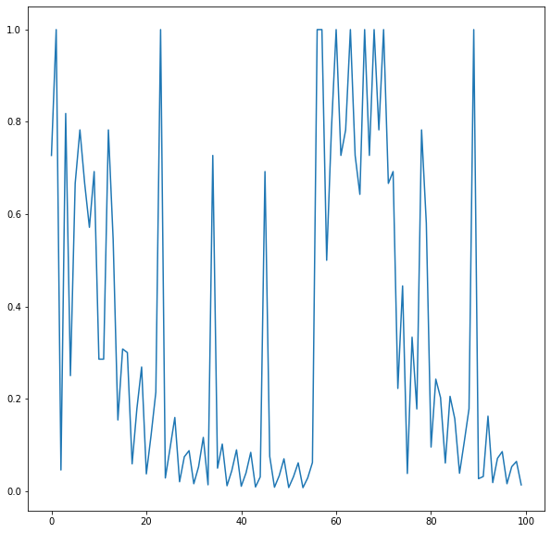
STL 100 Runs - F1 Score – Raw Data
Threshold- Manually set to 1000
Average F1 Value : 0.3312458093234123

Slide 13
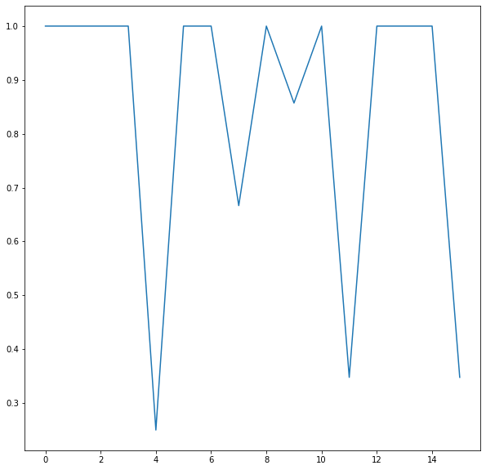
STL 15 Runs - F1 Score – Standardized Data
Threshold : Manually set to 0.5
Avg F1: 0.8418413561076604

Slide 14
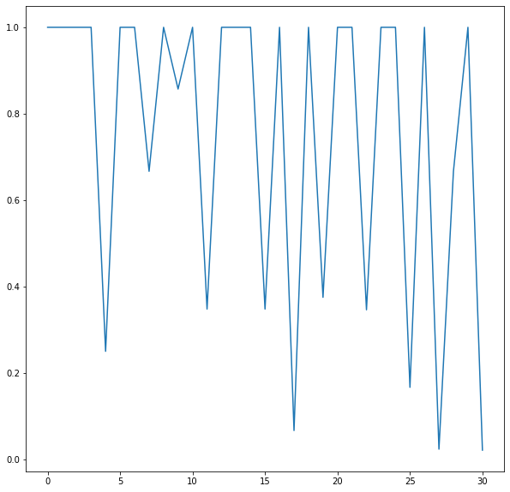
STL 30 Runs - F1 Score – Standardized Data
Avg F1: 0.7463039210124452

Slide 15
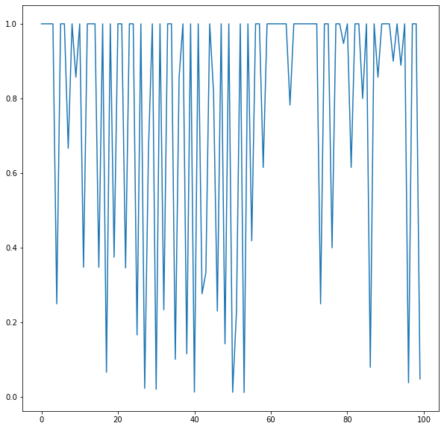
STL 100 Runs- F1 Score – Standardized Data
Avg F1: 0.7615574683059201

Slide 16
Auto Regression
Auto Regression on Yahoo S5 Dataset
Manual Threshold setting
2 Std Deviations threshold
IQR
MAD

Slide 17
Auto Regression Parameters
Model trained on len(series) * 0.66, tested on whole series
AR model fit on variable with 30 lags.

Slide 18
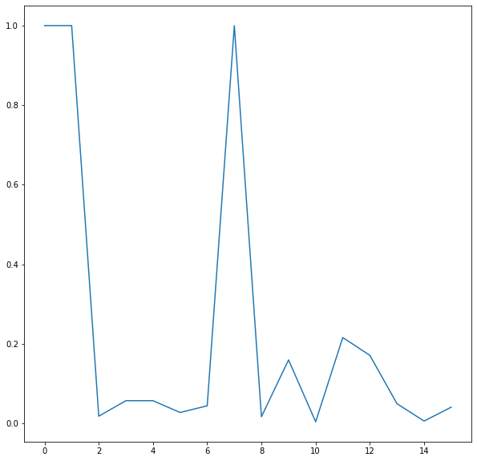
AR 15 runs – F1 Score
Average F1 :
0.2420691966355849

Slide 19
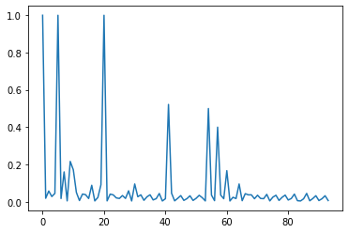
AR 100 runs
Average F1 - 0.07798339800940308

Slide 20
AR Limitations
Model overfits on training data, does not capture rest of model properly at all.

Slide 21
Moving Average
Moving Average on Yahoo S5 Dataset
Manual Threshold setting
2 Std Deviations threshold
IQR
MAD

Slide 22
Moving Average
Calculate Exponentially weighted Moving Average of Time series
Set manual threshold
If real value > threshold = outlier

Slide 23
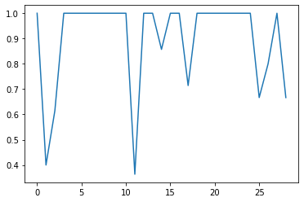
MA – 30 runs – Raw Data
Avg F1: 0.8994407890959615

Slide 24
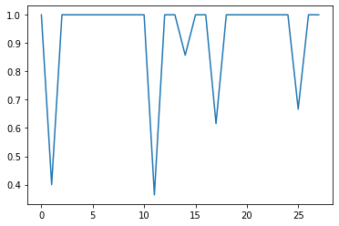
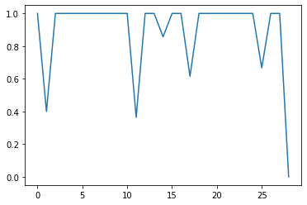
MA – 30 runs – Standardized Data
Avg F1: 0.9251010893868037
Avg F1: 0.8932010518217415
(if precision and recall are = 0 i.e. true positives = 0 and therefore the f1 score generated is taken as zero instead of infinity)

Slide 25
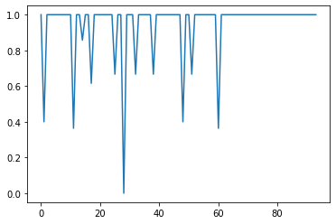
MA – 100 runs – Standardized Data
Avg F1: 0.9432602858134772

Slide 26
Comparative Results – Manual Threshold
Dataset\ Method | STL |  | AR |  | MA |  | ARIMA
 | Raw | Standardized | Raw | Standardized | Raw | Standardized | Raw | Standardized
Yahoo S5 – Synthetic Dataset: A2 folder
NASA Shuttle Dataset

Slide 27
Comparative Results – 2 std devs Threshold
Dataset\ Method | STL |  | AR |  | MA |  | ARIMA
 | Raw | Standardized | Raw | Standardized | Raw | Standardized | Raw | Standardized
Yahoo S5 – Synthetic Dataset: A2 folder
NASA Shuttle Dataset

Slide 28
Plots
F1 for STL, MA, AR, ARIMA on one plot.

Slide 29
One-Class SVM

Slide 30
TODO
K-fold cross validation
2 sets of results – with and without differencing
Consistent Standardization across STL, MA and AR
Try Results with Normalization differently. i.e. three diff results: Raw Data, Normalized and Standardized
Diff results: manual threshold, 2 std devs, IQR and MAD.

Slide 31
TODO
Moving Median https://anomaly.io/anomaly-detection-moving-median-decomposition/index.html
SARIMA
Isolation trees/forests
One class SVM
SANN – Seasonal Artificial Neural Networks
ARCH and GARCH

